Slide 1
RStudio Cloud

Slide 2
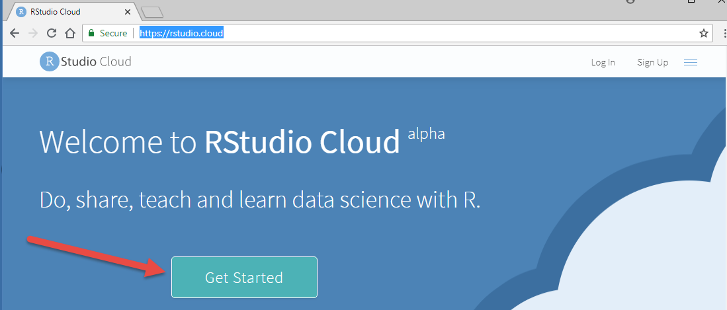
Download RStudio Cloud
Download from: https://rstudio.cloud/

Slide 3
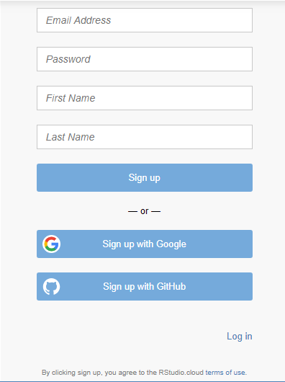
Create a log-in
Sign-up or Log in if you already have an account
Note: You can use your google or GitHub account if you have one

Slide 4
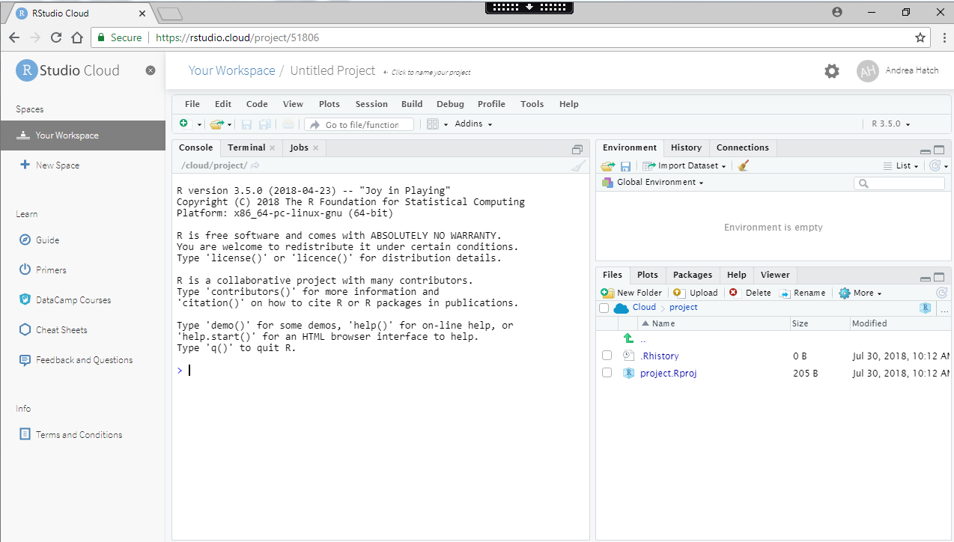
Get Started
To get started I selected New Project and you are ready to go

